Slide 1
Summer Intern project
Topic-Control Pc using hand Gesture(using image processing)
BY-Sourav Jaiswal
IIT(BHU),varanasi
mentor-Bulla Rajesh

Slide 2
Introduction
Ability to interact with machine efficiently through human computer interaction
The video-based approaches claim to allow the signer to move freely without any instrumentation attached to the body.
Trajectory, hand shape and hand locations are tracked and detected by a camera.
Using the concept of gesture recognition ,it is possible to point a finger at the computer screen so that the cursor will move accordingly

Slide 3
Problem Statement
The problem statement is to control the device through hand gestures in real time.
1. To detect number of fingers present in front of the webcam.
2. To assign task with every gesture like (opening mozilla firefox when 5 fingers detected) .
3. To control mouse cursor through hand Gesture using image processing.
4.To perform tasks like Scroll up ,scroll down ,left click and right click through hand gestures.

Slide 4
CHALLENGES
Can we recognize gestures in real time!
Can we maintain robustness with changing environment!.
3. Can we detect gestures at any orientation!
4. Can it work with all individuals!

Slide 5
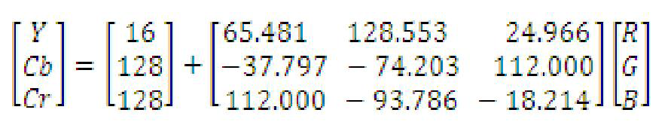
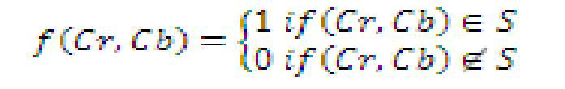
From Research papers and Work till now..
From 1 and 2
In YCbCr colorspace
the single component “Y” represents luminance information,.
Component Cb is the difference between the blue component and a reference
Cr is the difference between the red component and a reference value.
(1)
YUV colour space and camshaft algorithm:-
1.All the frames are taken into consideration
2.Using YUV colour space skin colour based segmentation is performed

Slide 6
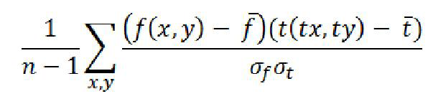
The Template Matching cross-correlation involves
1.simply multiplying together corresponding pixels of the signer image
2.here is called the Target image and the Template and then summing the result.
(from 2)
(2)

Slide 7
Process Involved
1. Image acquisition
2. Colour Segmentation
3. Hand Detection
4. Skin Detection
5. Image Segmentation
6. Image filtering
7. Gesture Recognizing
8. link with OS
9.Apply commands

Slide 8
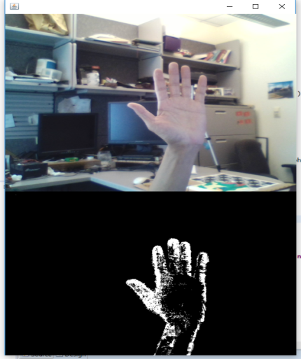
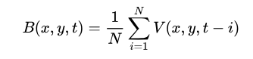
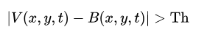
Background subtraction
It is a Gaussian Mixture-based Background/Foreground Segmentation Algorithm.
It uses a method to model each background pixel by a mixture of K Gaussian distributions (K = 3 to 5).
While coding, we need to create a background object using the function, cv2.createBackgroundSubtractorMOG().
(1)
Fig-7 Showing Background Reduction
(2)

Slide 9
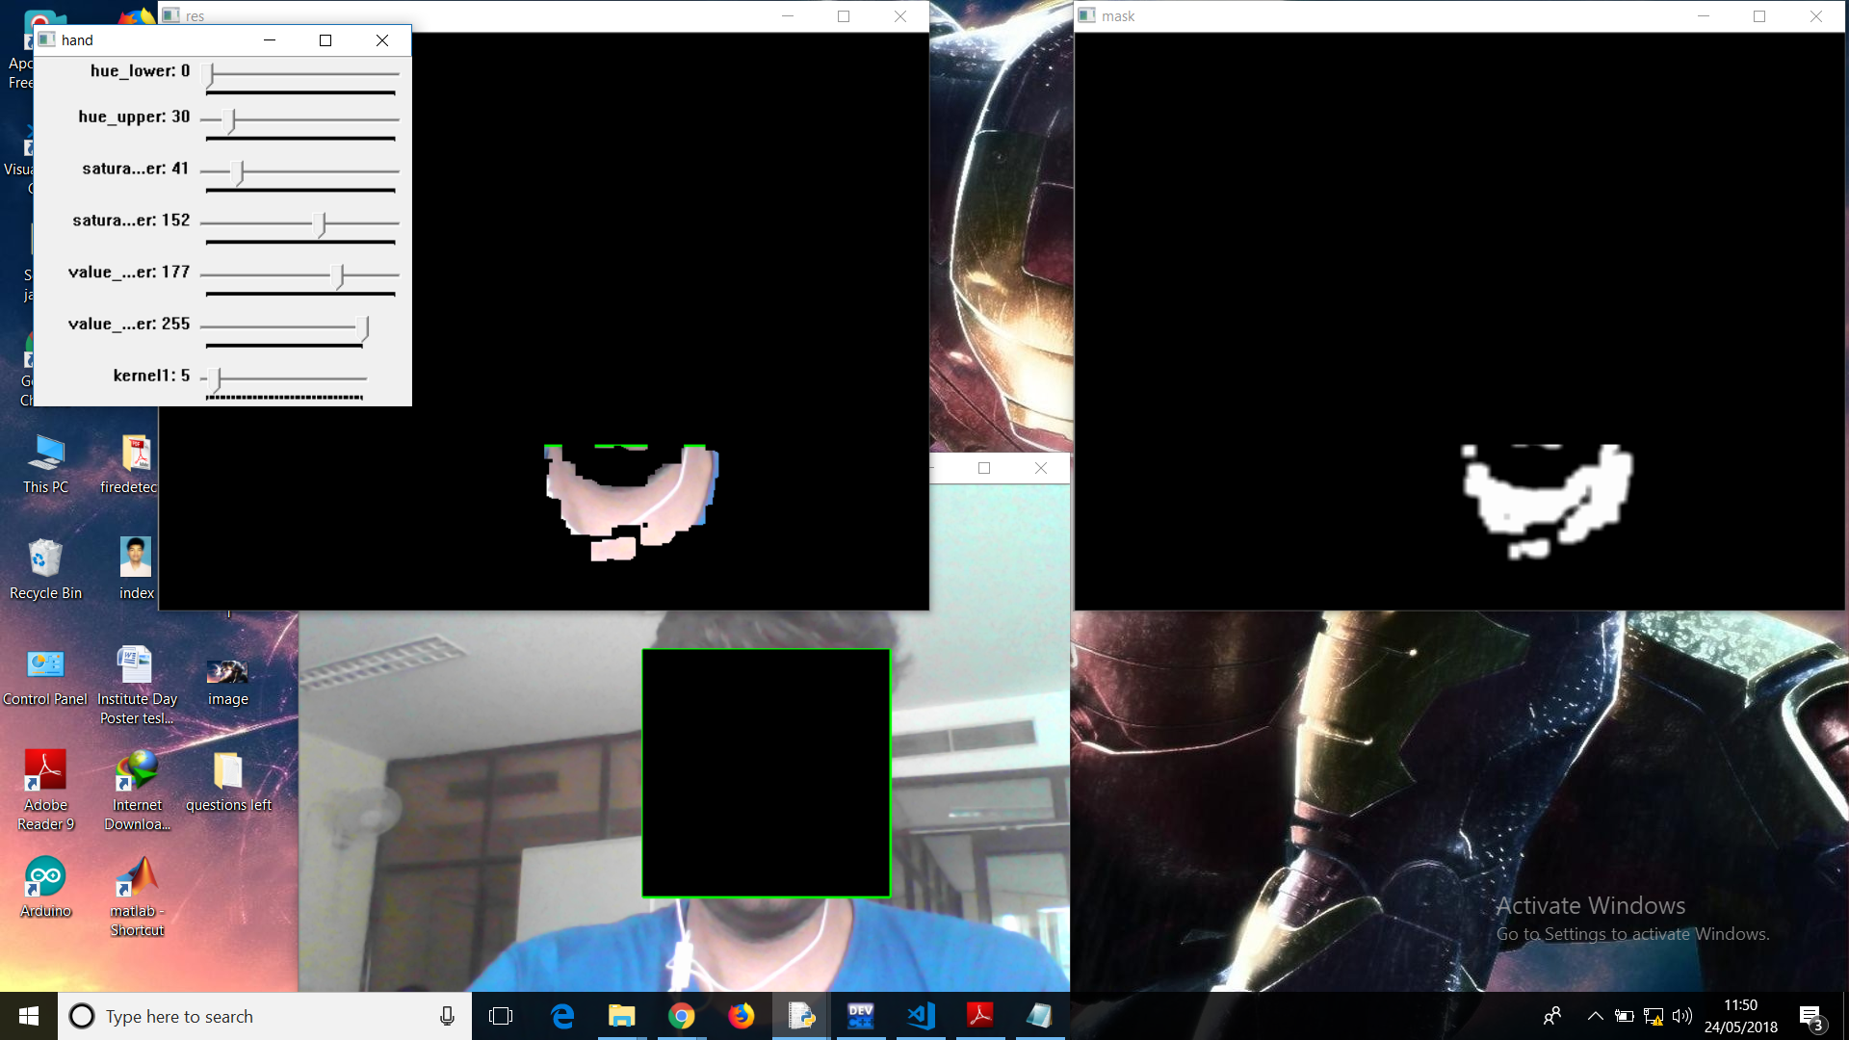
BACKGROUND SUBTRACTION( our output)
Img-1 showing subtracted background

Slide 10
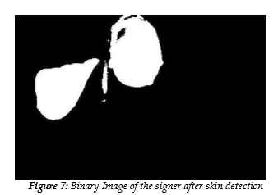
First Step- Skin Detection
X
Anticipated Static Gesture Set:-
1.Application interface will be provided after recognition of specified posture for action.
2.For the mouse cursor movement the centre of the hand gesture window was passed as a mouse cursor.
Hand Segmentation Using HSV Color Space And Sampled Storage Approach:-
1.The H, S and V separation was done using following equations. V=max{R,G,B} δ= V-min{R,G,B} S=δ/V

Slide 11
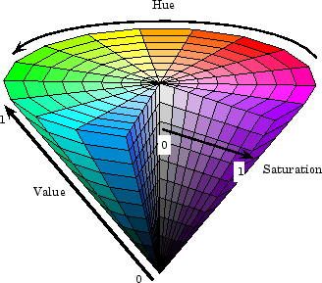
Hue Saturation Value (HSV) Color Model
As H value varies from 0-1,color changes from red,green,yellow and rest back to red.
S value(saturation) varies from 0-1,from unsaturated (shades of grey) to fully saturated (no white component).
The corresponding V value varies the brightness.
Better than RGB model as getting a
specific color is more easy here.
dfdFigure-3

Slide 12
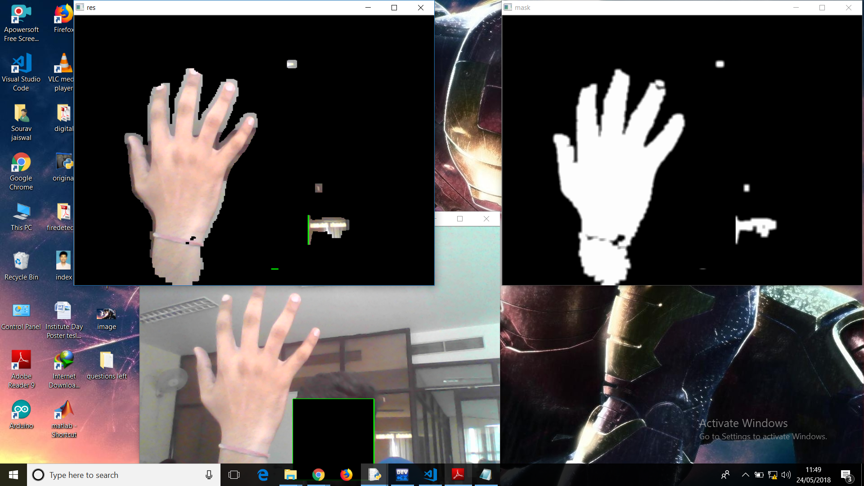
SKIN DETECTION(our output)
Img-2 showing hand with background and face removed

Slide 13
STEP2-HAND DETECTION AND RECOGNITION MODELS
Hidden Markov Model:-
1. Hidden Markov Models (HMM) model deals with the dynamic aspects of gestures.
2. After filtering, skin colour pixels are gathered into blobs.
Convex Hull(used in opencv):-
1. convex curves are the curves which are always bulged out, or at-least flat.
2.And if it is bulged inside, it is called convexity defects
Using Time Flight Camera:-
1.This approach uses x and y-projections of the image and optional depth features for gesture classification.

Slide 14
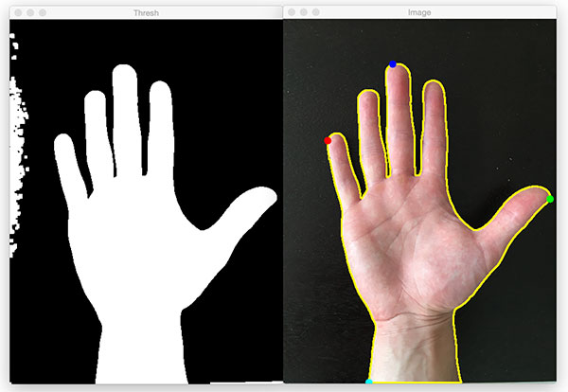
Naïve Bayes’ Classifier:-
1.It is based on classifying the different gestures according to geometric based invariants.
2.Obtained from image data after segmentation
Appearance Based Approach:-
1.This method use image features to model the visual appearance of the hand
2.Compare these parameters with the extracted image features from the video input.
Fig-4 Showing hand Detection in image

Slide 15
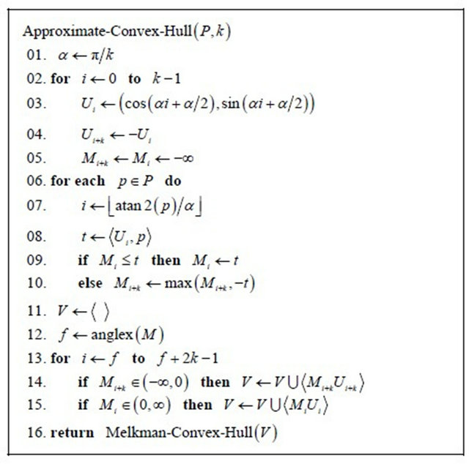
Convex Hull(used in opencv)
cv2.convexHull() function checks a curve for convexity defects and corrects it.
convex curves are the curves which are always bulged out, or at-least flat
if it is bulged inside, it is called convexity defects.
Eq-3

Slide 16
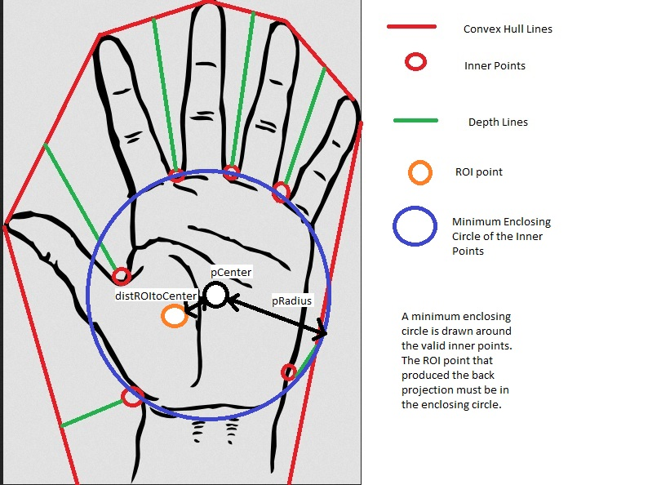
For example, check the below image of hand[FIG-5]. Red line shows the convex hull of hand.
The double-sided arrow marks shows the convexity defects, which are the local maximum deviations of hull from contours.
PYTHON SYNTAX- hull = cv2.convexHull(points[, hull[, clockwise[, return Points]]
FIG-5 showing convex hulls

Slide 17
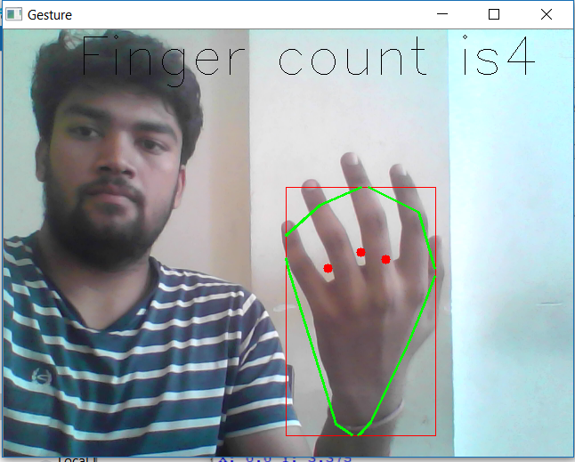
CONVEX HULL(our output)
Img-3 showing convex hull with green color and defects in red

Slide 18
STEP-3 ALGORITHMIC TECHNIQUES FOR RECOGNIZING HANDPOSTURES AND GESTURES
A. Template Matching :-
1.The template matching is a method to check whether a given data record can be classified
2. And as a member of a set of stored data records.
B. Feature Extraction Analysis:-
The low-level information from the raw data is analyzed .
Produce higher-level semantic information and are used to recognize postures and gestures .
.The system recognized these gestures with over 97% accuracy

Slide 19
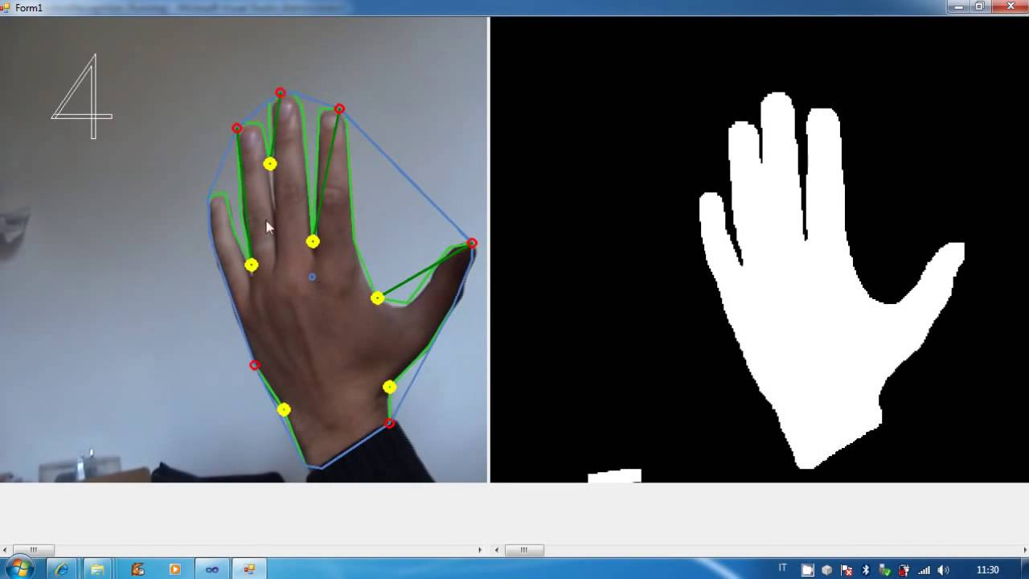
C. Active Shapes Model:-
A technique for locating a feature within a still image is called Active shape models or “smart snakes”.
E. Linear Fingertip Models:-
1.Model assumes most finger movements are linear , comprise very little rotational movement.
2. The model uses only the fingertips as input data .
3.Permits a model that represents each fingertip trajectory through space as a simple vector.
Fig-6 showing number of fingers detected through LFM

Slide 20
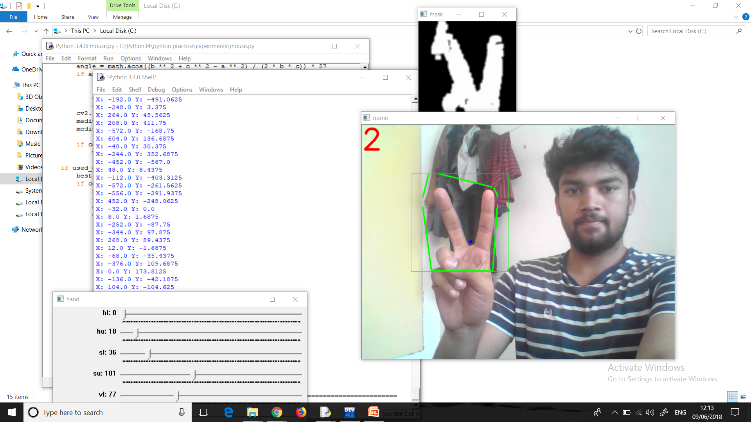
FINGERS DETECTED(our output)
Img-4 detecting number of fingers

Slide 21
Language and Libraries used
Language used-PYTHON
Libraries used- There are many libraries of python that has been used-
1.CV2-It is the most important python library used
2.Numpy and matplotlib.
3.Libraries like math ,time were also used.
4.Pyautogui is used for controlling mouse through python.
5.Subprocesses and os are 2 libraries used for importing system

Slide 22
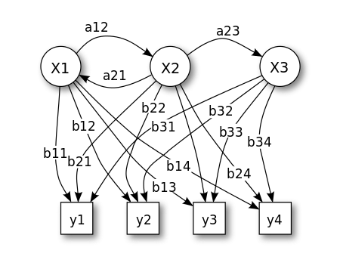
HIDDEN MARKOV MODEL(for Gesture Regognition)
System being modelled is assumed to be a Markov process with unobserved (i.e. hidden) states.
Hidden Markov model, the state is not directly visible, but the output dependent on the state, is visible.
Each state has a probability distribution over the possible output tokens.
The sequence of tokens generated by an HMM gives some information about the sequence of states
This is also known as pattern theory,
Figure 8. Probabilistic parameters of a hidden Markov model

Slide 23
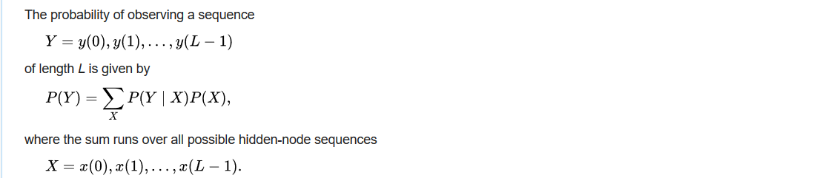
Mathematical description(hidden markov model)
Probability of an observed sequence
This requires summation over all state sequence.
Applying principal of dynamic programming ,we can handle the forward algo.
(4)

Slide 24
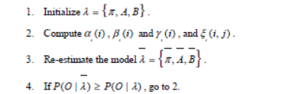
Using HMM in Gesture Recognition
There are three basic features: location, orientation and velocity.
Orientation feature is the best in term of accuracy results. And, our system is focusing on continuous hand motion of gesture.
3. Probability after the hmm to compute is quite correct.
That’s why we take the HMM to recognize our hand gesture in this system.
We use Baum-Welch algorithm for training the initialized parameters of HMM to provide the trained parameters.
(5)

Slide 25
Image acquisition
PROCESS INVOLVED
First the frame is taken through live feed from webcam
Then we have to segment out the colour of our skin ,for that background reduction is done.
After the hand is recognized fine tuning like erosion and dilation is done to segment out the fingers.
Once the fingers are detected ,serial communication between OS and code is done.
Then the action is implemented.
Same is the case for mouse cursor.
segmentation
Skin detection
Erosion, dilation
masking
Gesture Detection
Convex hull
Contour detection
Link with OS
Execute command

Slide 26
Building Image Processing Embedded Systems using Python
Import OS in python.
Import Subprocess and pyautogui in python
When the desired gesture comes call subprocess.call().
It is to give command through python
Pyautogui.moveRel() to move mouse cursor

Slide 27
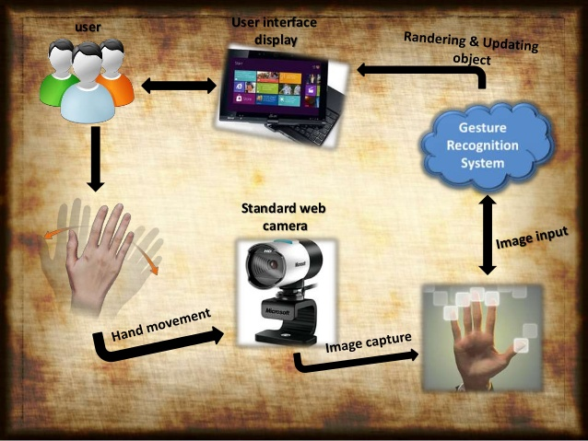
Cyclic Process

Slide 28
APPLICATION
Controlling Robots without any physical contact between human and computer.
Give presentation without touching mouse pad.
Control home Appliances like (TV) through hand gestures.
Suitable for physically impaired people to operate the devices within the room.
For controlling the traffic signals as per the wish of traffic controller to reduce the problem of traffic jam at peak hours.

Slide 29
REFERENCES
1.Hand Gesture Recognition based on Digital Image Processing using MATLAB by Tahir Khan, IJSERVolume 6, Issue 9, September 2015
2.HMM based hand gesture recognition: a review on techniques and approaches by MONI , DIU Journal of Science and Technology Volume 5,Issue 2,July 2010
3.Hand Gesture Recognition System,by Gaurav Talukdar International Journal of Scientific and Research Publications, Volume 4, Issue 2, February 2014
4.A Research Study of Hand Gesture Recognition Technologies and Applications for Human Vehicle Interaction by Carl A. Pickering*, Keith J. Burnham†, Michael J. Richardson*

